Slide 1


Image by Midjourney
Avoiding predatory publishers and identifying suitable journals
Image created in Midjourney on Discord

Slide 2
Coming up….
Quick introduction and mentimeter
Understanding journal publishing and Open Access
Avoiding ‘predatory’ journals and publishers
Let’s look at some journals together! / Q&A

Slide 3


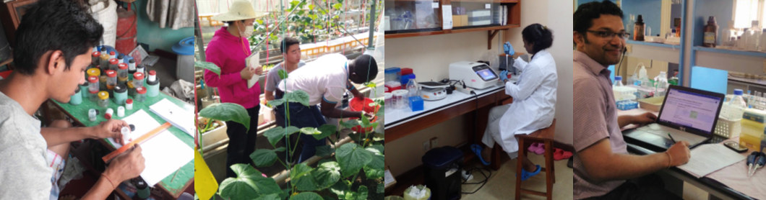
AuthorAID was launched to support researchers in developing countries, and has a community of over 25,000 researchers in 174+ countries
Free online training in research and proposal writing
Free Online mentoring and collaboration
Free resources and training materials
www.authoraid.info
Notes:
AuthorAID.info – 17,000 members from 174+ countries
Moodle – MOOCs trained over 9000 researchers in 100+ developing countries
Mention CSIR

Slide 4
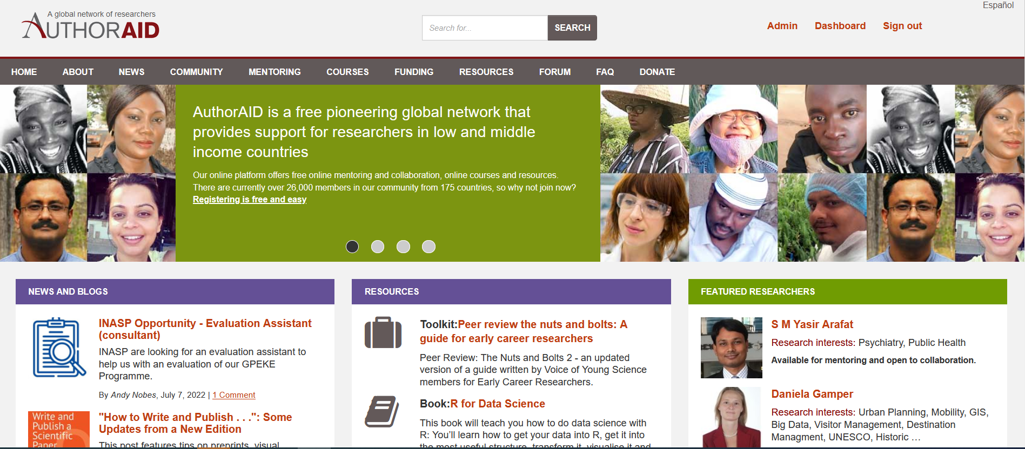
Upcoming MOOCs
AuthorAID.info
Research Writing in the Sciences - 9th September to 21st October 2019 (6 weeks)
Research Writing in the Social Sciences - 6th April 2020 to 19th May 2020 (6 weeks)

Slide 5

Failsafe ways to avoid predatory journals
If you could choose one strategy, do one of these…
Know the journals in your field
Don’t pay to publish
Only publish in ‘indexed’ journals

Slide 6

Go to menti.com and use code 1526 5593

Slide 7

Know the journals in your field

Slide 8

The world of academic publishing is confusing
Familiarise yourself with the major and minor journals in your field
Understand the basics of Open Access publishing

Slide 9
“I need to find a journal that doesn’t charge a fee and can publish quickly”
STOP!
Most journal publishing is FREE to the author. Don’t assume you have to pay.
Sorry, peer review usually takes time.
Q: What is your discipline?
Q: What audience do you want to reach?
Q: Do you want/need to publish Open Access?
Q: Do you need to publish in an ‘international’ journal?
Q: Does it need to be indexed in Web of Science, Scopus or Medline?
Q: What journals do your peers publish in?

Slide 10

Importance of choosing the right journal
There are tens of thousands of academic/scientific journals in existences – perhaps up to 60,000 (Ulrich’s Periodicals Directory)
There is a lot of choice – don’t feel you have to submit to the first journal you come across
Once you’ve identified a suitable journal*, take 5-10 minutes to check the journal website

Slide 11

Different types of academic journal
“Top tier” multidisciplinary journals
Nature
Science
Philosophical Transactions
PNAS
“Megajournals”
Plos One
Scientific Reports
F1000
PeerJ
SageOpen
“Top tier” single field journals
Lancet
Cell
New England Jnl of Medicine
Journal of Political Economy
Chemical Reviews
‘Regional’ journals
Chinese Journal of Ecology
Malawi Medical Journal
Sri Lanka Journal of Psychiatry
Croatian Medical Journal
Revista Colombiana de Estadistica
International Specialised journals
Lancet Diabetes and Endocrinology
Journal of Supply Chain Management
Pavement Research
Fungal Diversity
Journal of Conflict Resolution
Notes:
1665
In some fields of research, notably theoretical ones, the audience may be global. However, some research projects are strongly connected to the local or regional context, or they address local or regional priorities. An international audience may not be very interested in the specifics of case studies, but they could be extremely important at a regional level. If you're working on such a project, a regional journal may be a good choice.
Takeaway – there are lots of journals out there but be sceptical of

Slide 12

Don’t pay to publish

Slide 13

Know how to play the game of publishing

Slide 14





The game of ‘Open Access’
Diamond Open Access??
Subscription?
Green
Open Access?
Gold
Open Access?
Hybrid?

Slide 15

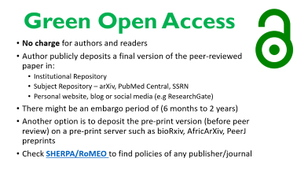
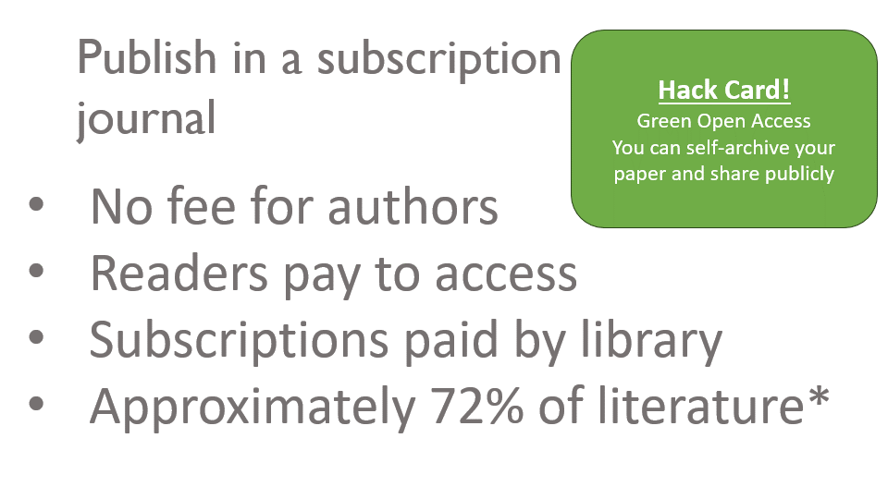
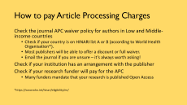
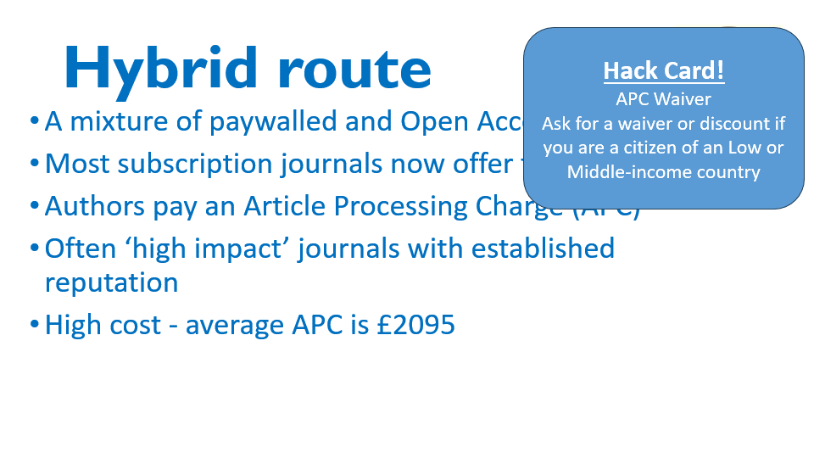
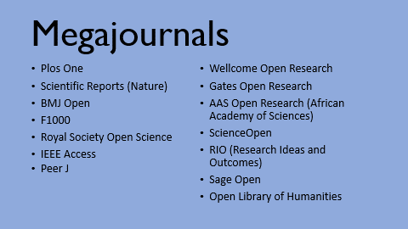
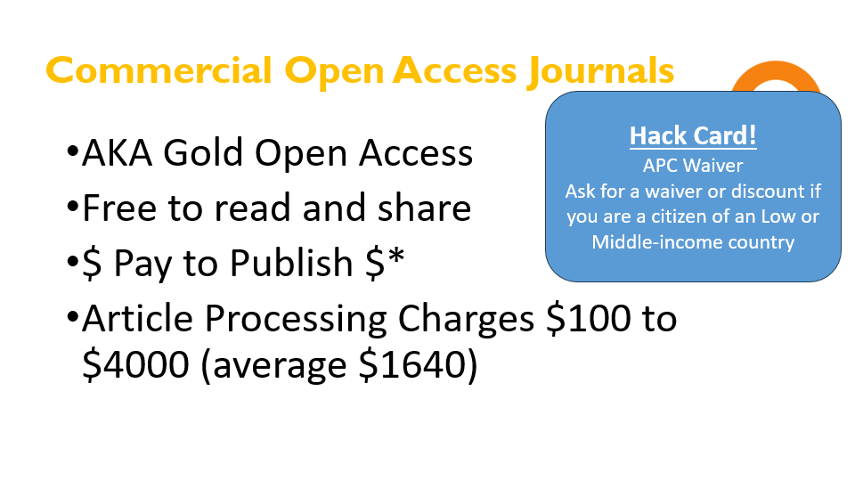
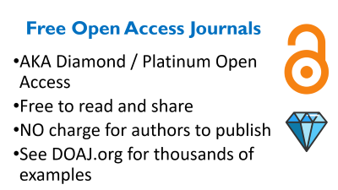
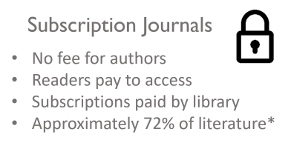
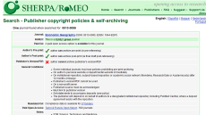
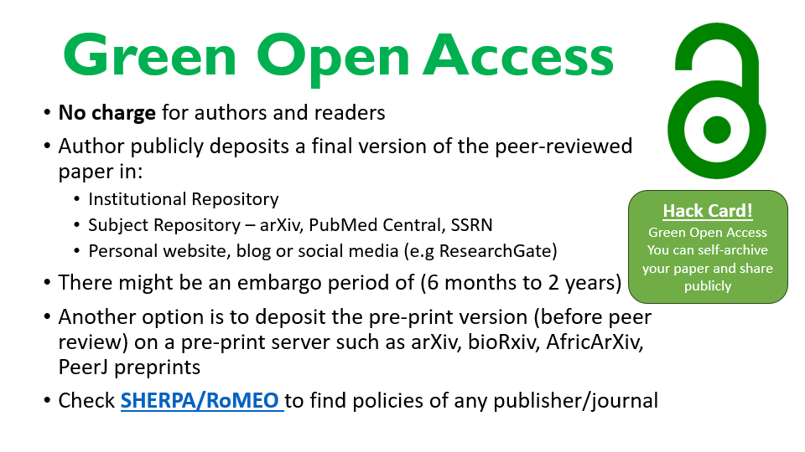
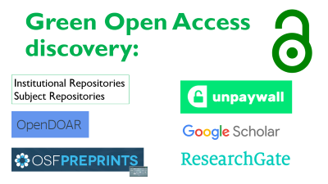
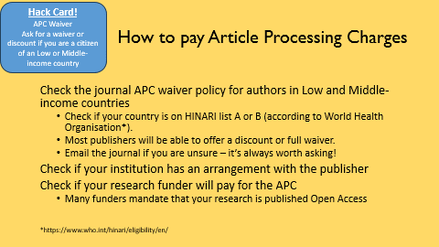
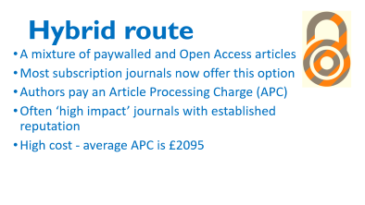
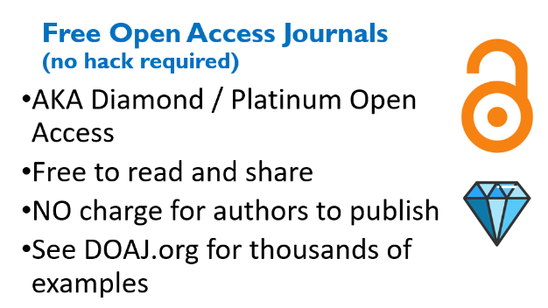

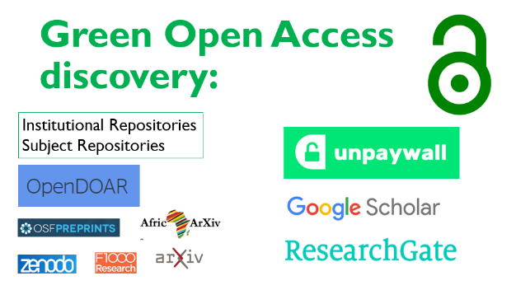
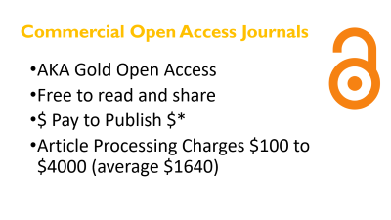

Different ways to publish your research
Open access journals
Approx. 72% of literature is paywalled*
Approx. 45% of literature published in 2015 was Open Access*
Piwowar, Priem et al. (2018)
https://www.ncbi.nlm.nih.gov/pmc/articles/PMC5815332/

Slide 16
Publish in a subscription journal
Hack Card!
Green Open Access
You can self-archive your paper and share publicly
No fee for authors
Readers pay to access
Subscriptions paid by library
Approximately 72% of literature*

Slide 17

Hybrid route
Hack Card!
APC Waiver
Ask for a waiver or discount if you are a citizen of an Low or Middle-income country
A mixture of paywalled and Open Access articles
Most subscription journals now offer this option
Authors pay an Article Processing Charge (APC)
Often ‘high impact’ journals with established reputation
High cost - average APC is £2095

Slide 18

Commercial Open Access Journals
Hack Card!
APC Waiver
Ask for a waiver or discount if you are a citizen of an Low or Middle-income country
AKA Gold Open Access
Free to read and share
$ Pay to Publish $*
Article Processing Charges $100 to $4000 (average $1640)

Slide 19
Free Open Access Journals (no hack required)
AKA Diamond / Platinum Open Access
Free to read and share
NO charge for authors to publish
See DOAJ.org for thousands of examples

Slide 20

Green Open Access
No charge for authors and readers
Author publicly deposits a final version of the peer-reviewed paper in:
Institutional Repository
Subject Repository – arXiv, PubMed Central, SSRN
Personal website, blog or social media (e.g ResearchGate)
There might be an embargo period of (6 months to 2 years)
Another option is to deposit the pre-print version (before peer review) on a pre-print server such as arXiv, bioRxiv, AfricArXiv, PeerJ preprints
Check SHERPA/RoMEO to find policies of any publisher/journal
Hack Card!
Green Open Access
You can self-archive your paper and share publicly

Slide 21










Green Open Access discovery:
Institutional Repositories
Subject Repositories

Slide 22
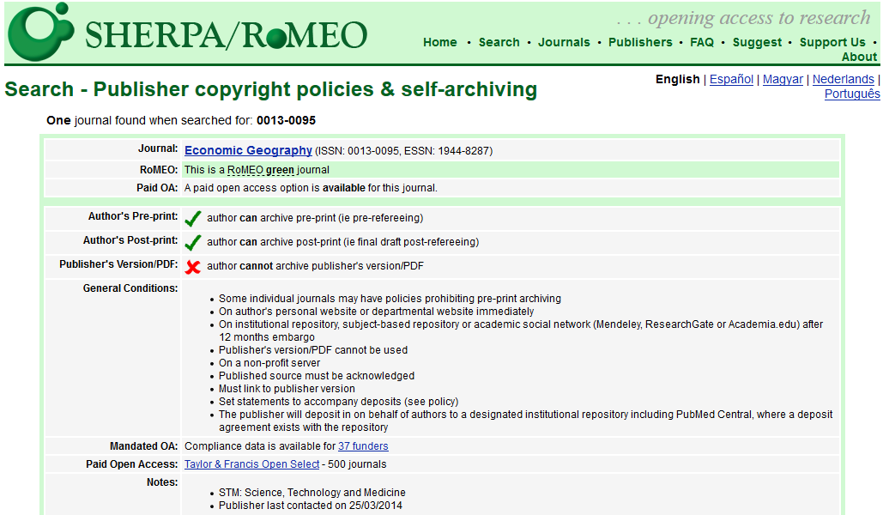

Slide 23
How to pay Article Processing Charges
Hack Card!
APC Waiver
Ask for a waiver or discount if you are a citizen of an Low or Middle-income country
Check the journal APC waiver policy for authors in Low and Middle-income countries
Check if your country is on HINARI list A or B (according to World Health Organisation*).
Most publishers will be able to offer a discount or full waiver.
Email the journal if you are unsure – it’s always worth asking!
Check if your institution has an arrangement with the publisher
Check if your research funder will pay for the APC
Many funders mandate that your research is published Open Access
*https://www.who.int/hinari/eligibility/en/

Slide 24
If you do need to pay for Open Access, what should you get for your £$€s?
Rigorous peer review
Publishing quality (incl. digital infrastructure, permanent record)
Dissemination to a wide readership
Indexing
(But remember there may also be journals that provide all of this for free!*)

Slide 25
Megajournals
Plos One
Scientific Reports (Nature)
BMJ Open
F1000
Royal Society Open Science
IEEE Access
Peer J
Wellcome Open Research
Gates Open Research
AAS Open Research (African Academy of Sciences)
ScienceOpen
RIO (Research Ideas and Outcomes)
Sage Open
Open Library of Humanities

Slide 26
Global sources of academic journals – publishers and platforms
MDPI
Biomed Central
IET
Scientific Reports
Emerald
Taylor & Francis
Thieme
Institute of Civil Engineers
Springer Nature
Royal Society of Chemistry
Wiley Blackwell
Institute of Physics
MongoliaJOL
Ubiquity Press
Oxford University Press
Sage Publishing
Frontiers
Iran SID
China OA Journals (COAJ)
Elsevier
Cambridge University Press
American Chemical Society
Wolters Kluwer
IndMed
BMJ Group
Brill
DeGruyter
Hanspub (China)
IEEE
PeerJ
F1000
Hindawi
Plos One
AJSP (Algeria)
Directory of Arabic Journals
PakMedNet
J-Stage (Japan)
IMIST MSJ (Morocco)
India Academy of Sciences
KOAJ
CAMJOL
CODESRIA
African Journals Online
Nepal Journals Online
KoreaScience
Scientific African
BanglaJOL
Redalyc
Garuda (Indonesia)
AAS Open Research
Sri Lanka JOL
Bioline
ThaiJO
SciELO
AOSIS
Philippines e-Journals
SciELO SA

Slide 27
http://DOAJ.org

Slide 28
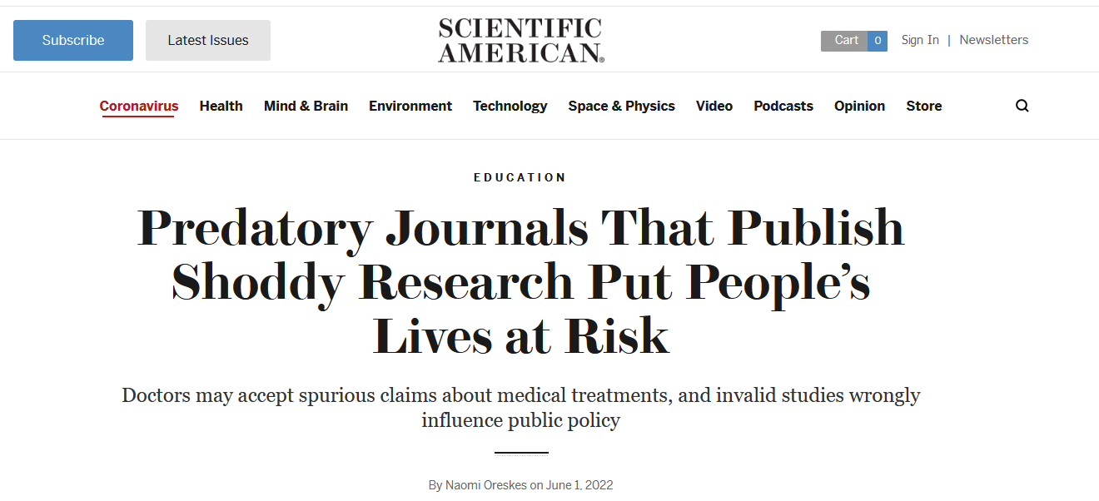
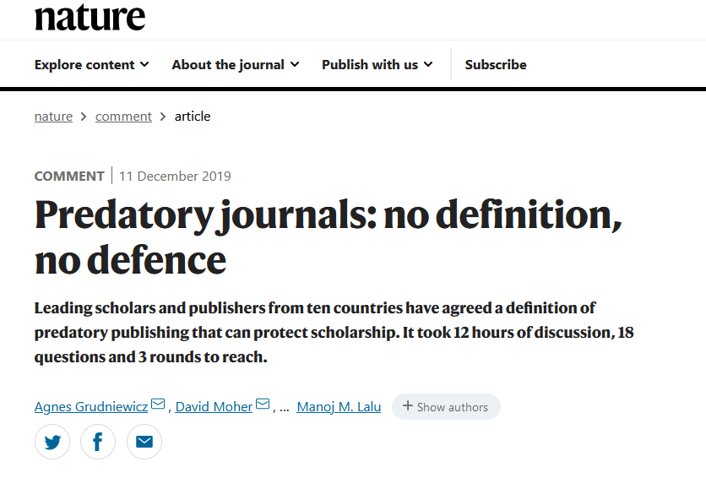

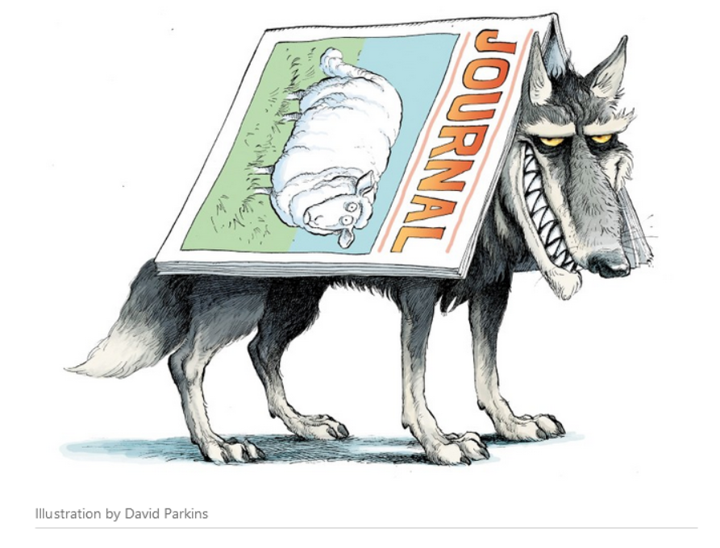

Slide 29

Remember….
You don’t need to pay to publish in a journal. It is often free to submit and publish a paper.
Therefore, if you are quoted over $100 (approx.) to publish your paper, you should be getting something significant in return. Expect the journal to be indexed in DOAJ, and one of: WoS, Scopus or Pubmed (Medline)

Slide 30

Only publish in indexed journals

Slide 31

What is a ‘predatory’ journal?
A low-quality publishing outlet that charges a fee to publish your paper, but does not provide a service that most would expect from an academic or scientific journal.
In other words – false advertising

Slide 32






The important journal indexes
Clarivate Web of Science (Previously Thomson Reuters) Master Journal List: http://mjl.clarivate.com/ (also referred to as as Journal Citations Reports or Science Citation Index) .
Scopus is also good indicator of a high-quality, credible journal. You can search to check if journals are indexed via this link: http://www.scimagojr.com/journalsearch.php
Pubmed/NLM catalog (medical journals). Check journal is included in MEDLINE: https://www.ncbi.nlm.nih.gov/nlmcatalog/
The Directory of Open Access Journals (DOAJ) https://doaj.org/search
(Impact Factor)
(CiteScore)
But what about
?

Slide 33

What is the Impact Factor?
The Impact Factor of a journal is calculated according to the number of citations that journal receives over the previous two years. https://en.wikipedia.org/wiki/Impact_factor
Not all journals have an Impact Factor, and it is not always a good indication of the best journals.
Impact Factor is an ‘article-level metric’ – it is not intended to assess the quality of individual articles.
To qualify for an Impact Factor, journals must be indexed in the Clarivate (Thomson Reuters) Web of Science.
Watch out for fake impact factors! Check http://mjl.clarivate.com/ to make sure the journal is making a legitimate claim about their indexing.

Slide 34

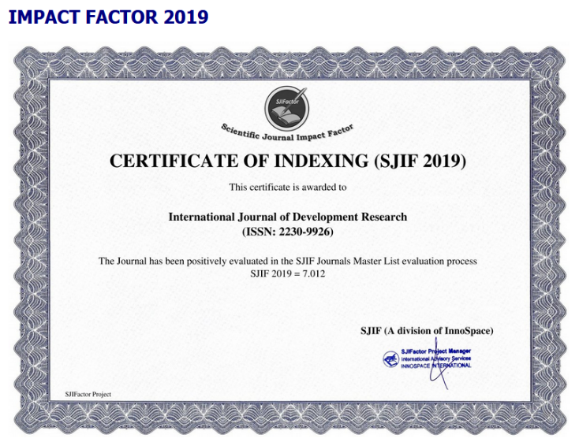
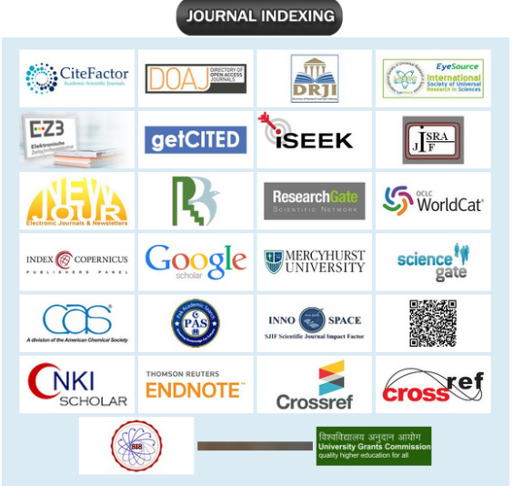
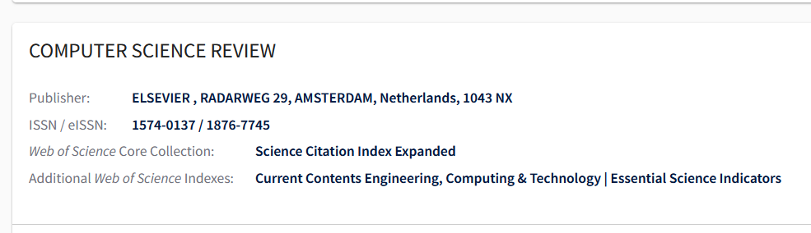

https://mjl.clarivate.com/
Notes:
Drake

Slide 35
‘Blacklists’ and ‘whitelists’
Blacklists
“Beall’s List” (continued by an anonymous author, highly disputed) https://beallslist.net/
“Predatory Reports” – anonymous
https://predatoryreports.org
Cabell’s Blacklist ($) https://www2.cabells.com/about-blacklist
Whitelists
Cabell’s Whitelist ($) https://www2.cabells.com/about-whitelist
DOAJ, Web of Science, Scopus, Pubmed (Medline)

Slide 36
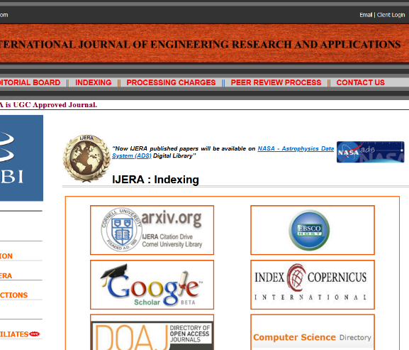

Critically examine the website
Does it carry out rigorous peer review? (???)
Does it charge a fee? Is this justified?
Is it indexed in a reputable or relevant database?
How does the journal talk about itself?
Does the Editorial Board look legitimate?
Does the publisher look credible?
Notes:
Some journals have bad websites

Slide 37



‘Predatory’ and poor journals - a spectrum of possibilities!
definite predatory or fake journals
that want your money for putting a PDF on a website
journal with low quality publishing practices (no charges)
‘High Impact’ &
‘International’ journals
Good journals
usually indexed
transparent practices
good information on website
Recognised Ed Board members
journal with low quality publishing practices
(charges £$)
Regional or niche journals which lack information on their website

Slide 38
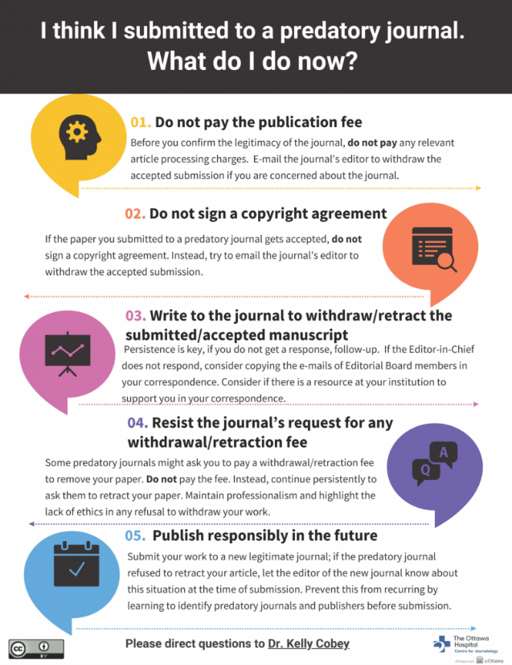
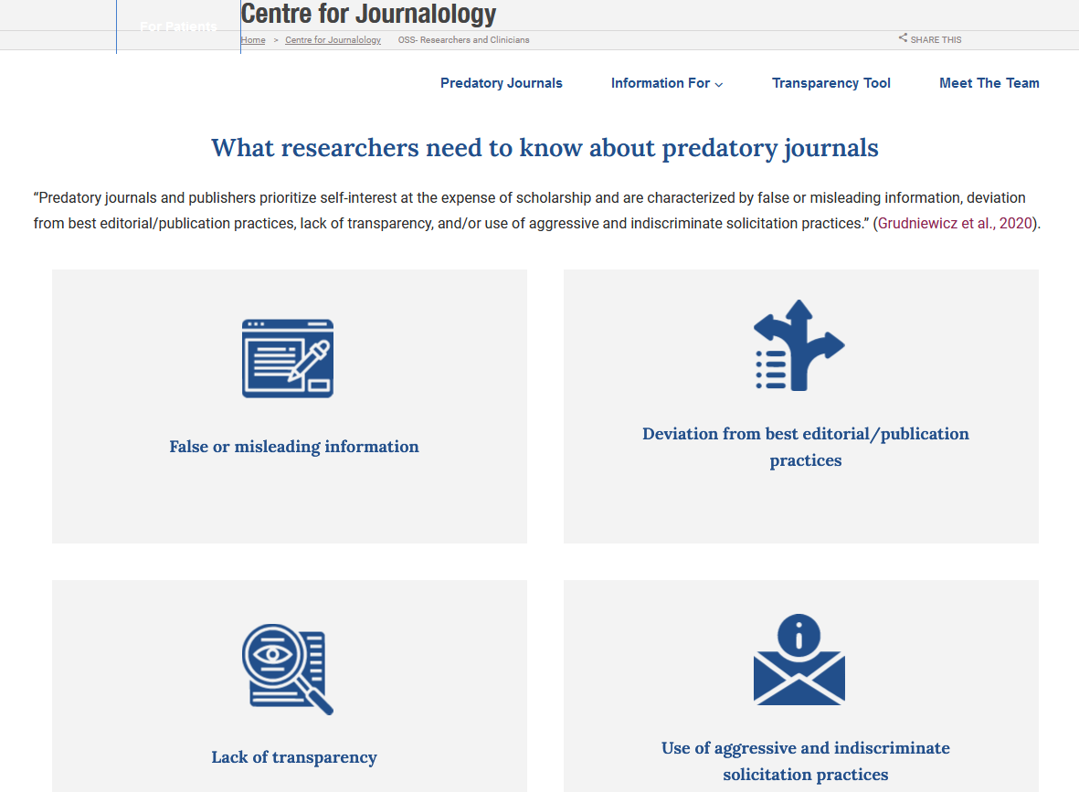
https://www.ohri.ca//journalology/oss-researchers-and-clinicians
Centre for Journalology

Slide 39
More quick tips – 6 things to remember
Don’t trust email invites and ‘Call for Papers’ (unless you recognise the sender)
Be sceptical of ‘international’ or ‘global’ journals, and those with a wide scope
Double-check claims of prestigious indexing and impact factors
Read the ‘Aims and scope’ or ‘About’ page – check the journal understands your field
Check who is publishing the journal – are they a credible scholarly organisation?
Check your reference lists – familiarise yourself with good journals in your field
From “A beginner’s guide to avoiding ‘predatory’ journals (using your critical thinking skills)” https://www.authoraid.info/en/news/details/1310/

Slide 40
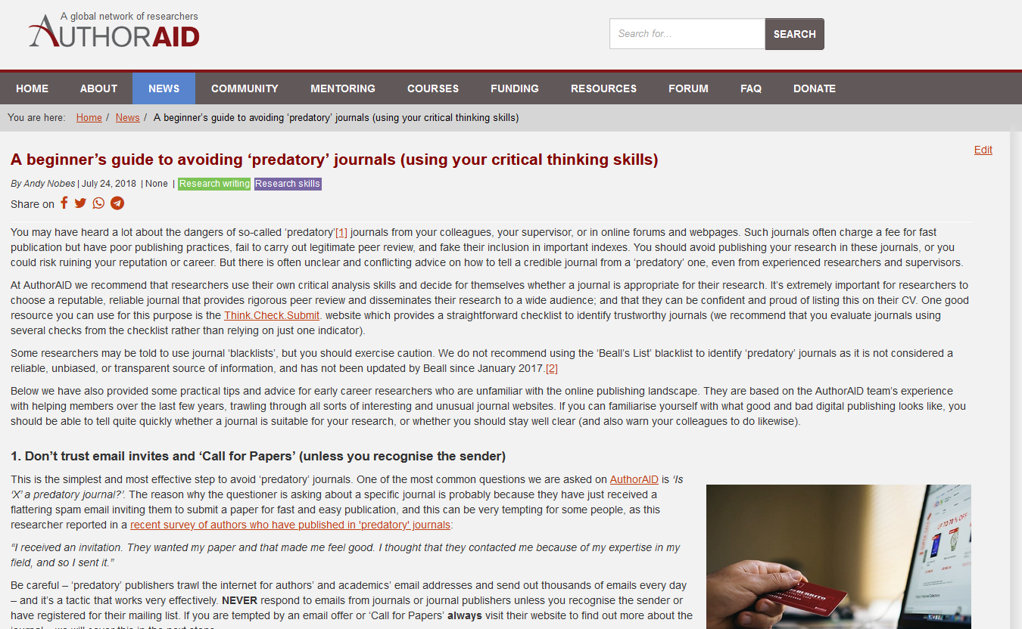
Don’t trust email invites and ‘Call for Papers’ (unless you recognise the sender)
Be sceptical of ‘international’ or ‘global’ journals, and those with a wide scope
Double-check claims of prestigious indexing and impact factors
Read the ‘Aims and scope’ or ‘About’ page – check the journal understands your field
Check who is publishing the journal – are they a credible scholarly organisation?
Check your reference lists – familiarise yourself with good journals in your field
A beginner’s guide to avoiding ‘predatory’ journals (using your critical thinking skills)
https://www.authoraid.info/en/news/details/1310/

Slide 41
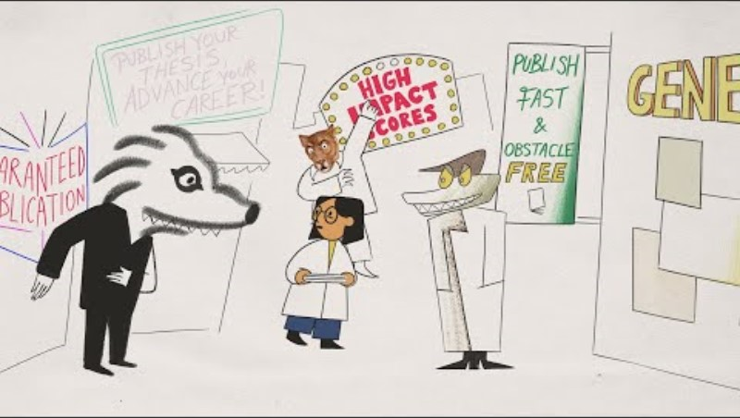
Publishing your research? How to avoid predatory journals | The Royal Society
https://www.youtube.com/watch?v=sIbpmkh5ORs

Slide 42
Any questions?
Andy Nobes anobes@inasp.info

Slide 43
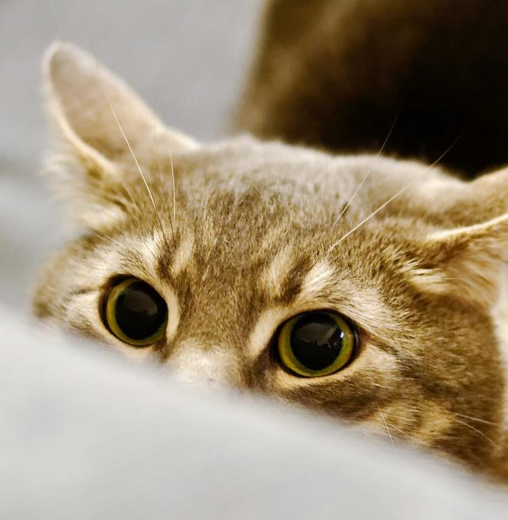
Let’s look at some journals!

Slide 44
Examples
Credible journals:
https://www.tandfonline.com/journals/rcoa20
https://datascience.codata.org/
https://www.hindawi.com/journals/jir/
https://joii-journal.springeropen.com/
https://www.journals.elsevier.com/archives-of-physical-medicine-and-rehabilitation
Not so credible journals:
http://www.journalijdr.com
http://www.journalijar.com/
http://www.sciencepublishinggroup.com/journal/index?journalid=153
https://www.omicsonline.org/mass-communication-journalism.php
http://www.ijhssi.org/index.html
http://www.ijera.com/index.html

Slide 45
Where to look for credible journals?
Google/ Google Scholar, but be specific.
‘Journal finders’ such as JournalGuide https://www.journalguide.com/
Directory of Open Access Journals (DOAJ) www.doaj.org
JANE http://jane.biosemantics.org/
Ravi Murugesan – ‘How to choose a journal that’s right for your research’ https://www.scidev.net/global/publishing/practical-guide/target-journal-right-research-communicate-publish.html
Duncan Nicholas – ‘How to choose a journal and write a cover letter’ https://dx.doi.org/10.4103/sja.SJA_691_18

Slide 46
Some other useful tips
Think.Check.Submit (www.thinkchecksubmit.org)
Check out the editorial board
Check the address
Watch out for ‘rapid publication’
Poor English
Author should retain copyright (e.g. via a CC-BY licence). Don’t sign over your rights without being 100% sure!
Watch an interactive version of this presentation (with journal example) on https://youtu.be/_U8DvLu28pE

Slide 47
Bonus slides

Slide 48
Author copyright and licensing
When you publish an article with a journal, you will be required to either transfer copyright or give the journal the right to publish. You may have to complete one of these forms:
Copyright transfer Copyright is transferred to the publisher or journal. Standard for subscription journals. Check the terms and conditions: can you share your work with colleagues, make copies, use in future work, use for teaching purposes? Before you sign over your copyright: check your author rights | Licence to publish Common for Open Access journals. You retain copyright of the work and can use, share and republish elsewhere. Work is usually published under an open Creative Commons licence – which give readers more rights. Check the licence terms of your paper – are you happy with it? Are you happy for it to be reused, adapted, or even used for commercial purposes?
Notes:
Question: how do you feel about people being able to share/copy/use in teaching/change/sell your work?

Slide 49
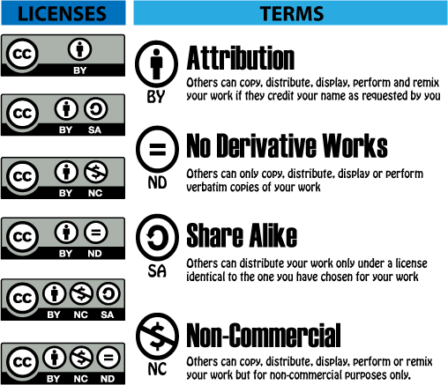
Creative Commons
These licences are often used in Open Access publishing to show users that they can share, copy, and reuse the work.
The CC-BY is the most ‘open’ licence, and the CC-BY-NC-ND is the least open, preventing any commercial use and changes to the work.

Slide 50
Another definition
“Predatory journals and publishers are entities that prioritize self-interest at the expense of scholarship and are characterized by false or misleading information, deviation from best editorial and publication practices, a lack of transparency, and/or the use of aggressive and indiscriminate solicitation practices.”
(Grudniewicz etal 2019 Nature 576:210-212)

